Slide 1
Digital image processing mid-term project oral presentation
系籍：光機電碩二 姓名：劉成震
學號：106327027

Slide 2
Schemes
Mid-term
Find theories or papers associated
Implement
Debug
Final-term
Compare with other enhancement methods (Result of each step or different coeff.)
Conclusion

Slide 3
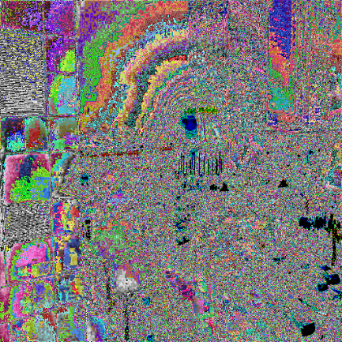
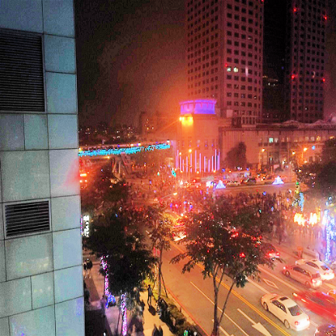
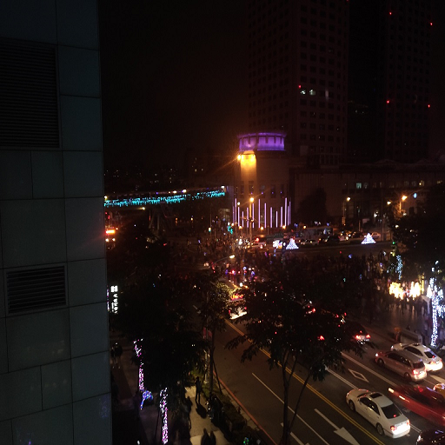
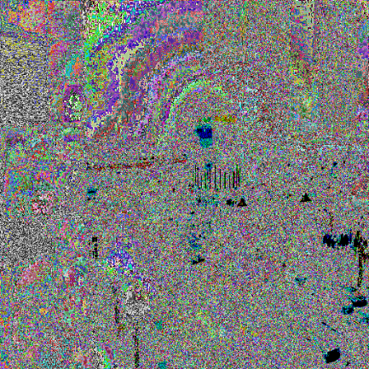
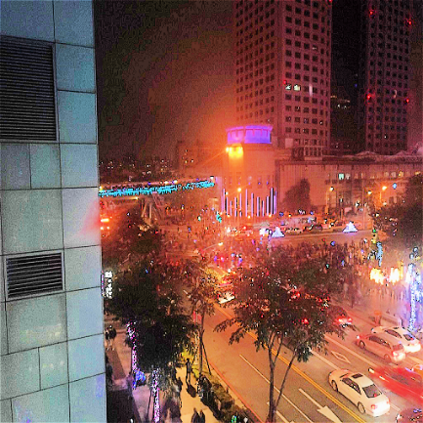
Picture 1 : Building
UnsharpCoef=0.2
Histogram equal
Origin Pic
PSNR : 29.62 dB
UnsharpCoef=1.2
Histogram equal
PSNR : 29.28 dB

Slide 4
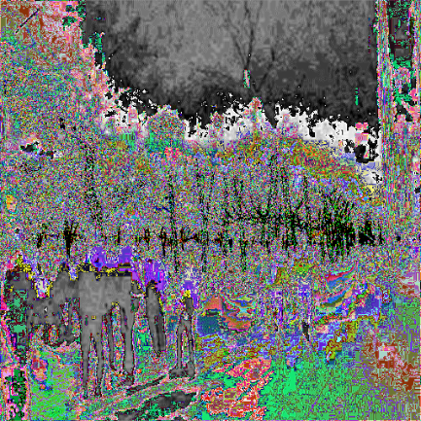
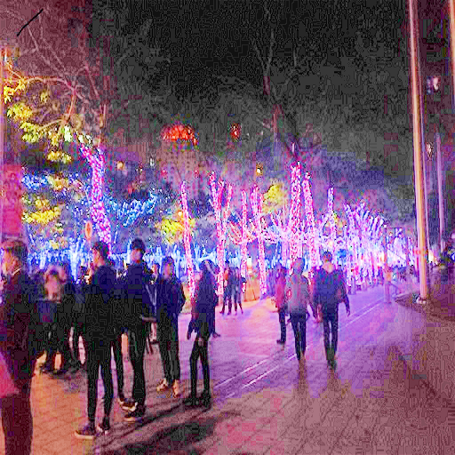
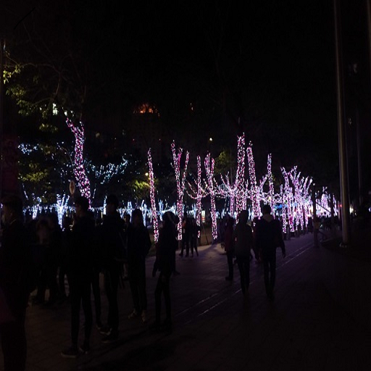
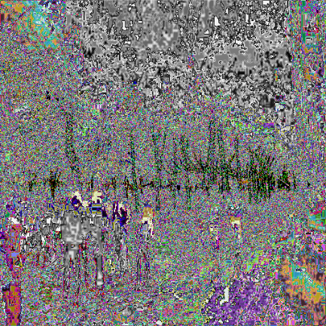
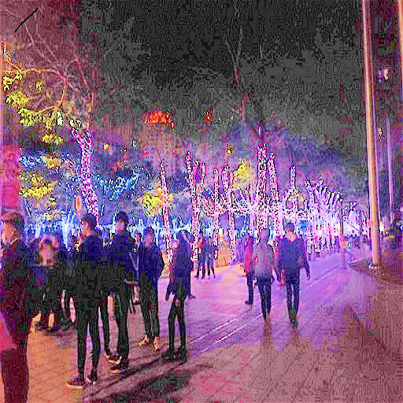
Picture 2 : Sidewalk
UnsharpCoef=0.2
Histogram equal
Origin Pic
PSNR : 28.11 dB
UnsharpCoef=1.2
Histogram equal
PSNR : 27.05 dB
4

Slide 5

Zoom In Pic 1

Slide 6
Zoom In Pic 2

Slide 7
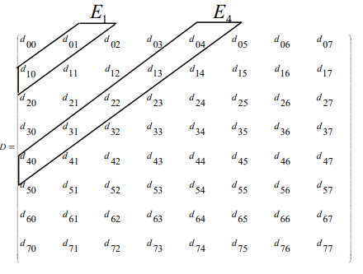
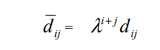
DCT Enhancement
d_{i,j} are DCT coeff.
/d_{i,j} are enhanced DCT coeff.

Slide 8
REf
Image Enhancement Using a Contrast Measure in the Compressed Domain Jinshan Tang, Senior Member, IEEE, Eli Peli, and Scott Acton, Senior Member, IEEE
Jinshan Tang, Eli Peli, Scott Acton, “Image Enhancement Using A Contrast Measure in the Compressed Domain,” IEEE Signal Processing Letters (In Press).

